Slide 1

Retail Data Pipeline
End-to-end data engineering on AWS
Praveen Kumar Muthukaruppan
API Gateway
Kinesis
Lambda
DynamoDB
S3
AWS Glue
Redshift
QuickSight
SQS
SNS
EventBridge
Step Fns

Slide 2
Problem Statement & Business Use Case
Why this pipeline was built — the challenges we set out to solve
Data Scattered
No Real-Time
Manual Pipelines
No unified view across transactions, customers, products — cross-domain analytics was impossible.
Fraud signals and high-value order alerts couldn't be acted on in time using batch-only processing.
CSV uploads, manual Glue runs and no alerting meant delays and errors in reporting.
BUSINESS USE CASES THIS PIPELINE ENABLES
Revenue Analysis
High-Value Alerts
Where is revenue coming from? How is it trending across 8 countries?
Auto-detect transactions > £990 via SQS + SNS.
Customer 360
Executive KPI Dashboard
Who are our highest-value customers? How do they behave across payment channels?
QuickSight with 7 materialised views — country revenue, shipping, lifetime tiers, product margin.

Slide 3
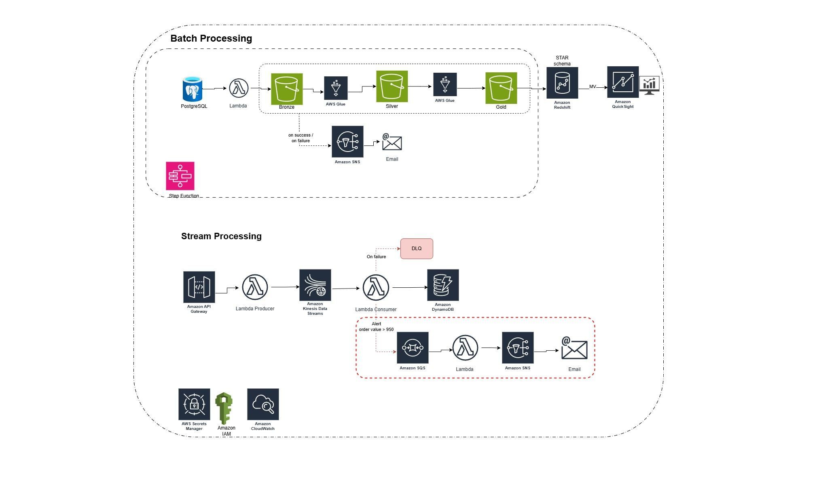
Architecture Overview
High-level data flow across all layers

Slide 4
Streaming Pipeline
Real-time ingestion via API Gateway + Kinesis + Lambda
01
Ingest
03
Alert
Python script POSTs transactions to API Gateway (POST /transactions). Lambda producer validates all 10 columns and pushes to Kinesis.
SQS triggers Lambda (sqs_to_sns) which publishes to SNS topic (praveen_topic) → email. Failed alerts go to DLQ (praveen-alerts-dlq) after 3 retries.
API Gateway
Lambda producer
Kinesis
SQS
sqs_to_sns
SNS → Email
02
Process
04
Store
Lambda consumer reads Kinesis batches, writes each record to DynamoDB.
DynamoDB used to store the data.
Lambda consumer
DynamoDB
SQS alert
DynamoDB

Slide 5
Medallion Architecture (S3)
Bronze → Silver → Gold data quality progression · Gold is the source for Redshift
BRONZE
SILVER
GOLD
Raw Layer
Cleansed Layer
Business Layer — Source for Redshift
Format: CSV
Format: Parquet
Format: Parquet
Raw ingested data exactly as received. No transformations — full fidelity.
Cleaned, validated, type-cast data. Columnar format for efficient querying.
Star schema tables stored as Parquet in S3 Gold. Glue JDBC transfers them into Redshift.

Slide 6
Batch Ingestion Layer
Initial & Incremental loads via AWS Glue · S3 Gold → Redshift
INITIAL LOAD
INCREMENTAL LOAD
Full historical load of all entities on first run.
Processes only new/changed data since last run.
Glue ETL Flow
After Each Glue Run
Bronze CSV → Silver Parquet → Gold Parquet (star schema)
REFRESH each of the 7 Materialised Views in Redshift
S3 Gold stores fact/dim tables ready for Redshift load
QuickSight → refresh SPICE for all 7 datasets

Slide 7
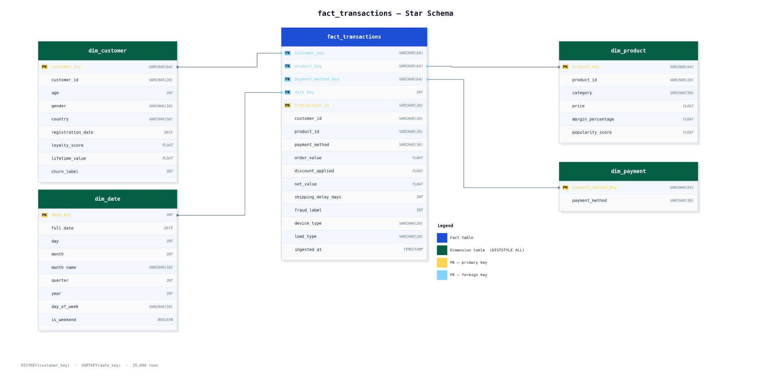
Redshift Star Schema
S3 Gold → Redshift (praveen schema) ·

Slide 8
Dashboard Insights — Explained
What each materialised view tells us about the business · alert threshold: order_value > £990
£10.18M
13,432
127
£407
Total Revenue
Unique Customers
High-Value Alerts
Avg Order Value
25,000 transactions
from 8 countries
order_value > £990
median £384
Sales by Country — 31x Revenue Gap
High-Value Alerts — 127 Orders > £990
USA leads at £3.71M (5,981 orders, avg £621). UK second at £2.16M. India at the bottom.
UPI leads with 55 alerts, Credit Card 26, Debit Card 24. Crypto has 13 payments breached the Upper limit.
Shipping Delays — Fulfilment Problem
Payment Distribution — UPI Dominant
37.7% of orders (9,415) fall in the Slow bucket (7-10 days). Only 8.4% are same-day. Standard (4-6 days) is 27.6% and Fast (1-3 days) 26.3%.
UPI accounts for 42.9% of all transactions (10,714). Credit Card 23.8%, Debit Card 19%, PayPal 9.5%, Crypto 4.8%.
Lifetime Value Tiers — Elite Majority
the Elite tier (>£15k lifetime value) has the most customers: 5,159. Starter tier (<£2k) has the fewest: 2,038. This means the customer base skews toward high-value, long-term customers — a healthy retention signal for the business.

Slide 9
Challenges
Implementing IAM permissions across services
Implementing Star Schema
Auto logout

Slide 10
Future Enhancement
Airflow Orchestration
CI/CD
DMS
Data Quality- Great Expectation to be implemented in Silver layer

Slide 11
Summary & Key Benefits
What this AWS architecture delivers
Near Real-time + Batch
Data Quality by Design
Instant Alerting
API Gateway → Kinesis → Lambda → DynamoDB handles near live transactions.
Bronze → Silver → Gold → Redshift
Bronze (raw CSV) → Silver (Parquet, clean) → Gold (star schema Parquet) progression. Raw data preserved at every layer. Redshift loaded from Gold — always clean.
127 high-value orders (> £990) auto-detected from 25,000. SQS + Lambda + SNS delivers email within seconds. DLQ ensures zero silent failures.
BI-Ready Insights
Fault Tolerant
Fully Serverless
7 QuickSight MVs— each view tells a distinct business story.
DLQ for failed alerts. DynamoDB Streams 24hr replay window.
API Gateway, Lambda, DynamoDB, Glue, Redshift Serverless, QuickSight SPICE — zero servers to manage. All auto-scaling. Run the pipeline once and REFRESH MVs to refresh insights.

Slide 12
Q&A
Thank you!

